Slide 1
00
自我介紹
LeeLee 粒粒
交作業的人
粒粒
姓名: 林依蒨
前清敬事房四品總管 / 小李子或李大總管
學號: 81360006 T

Slide 2
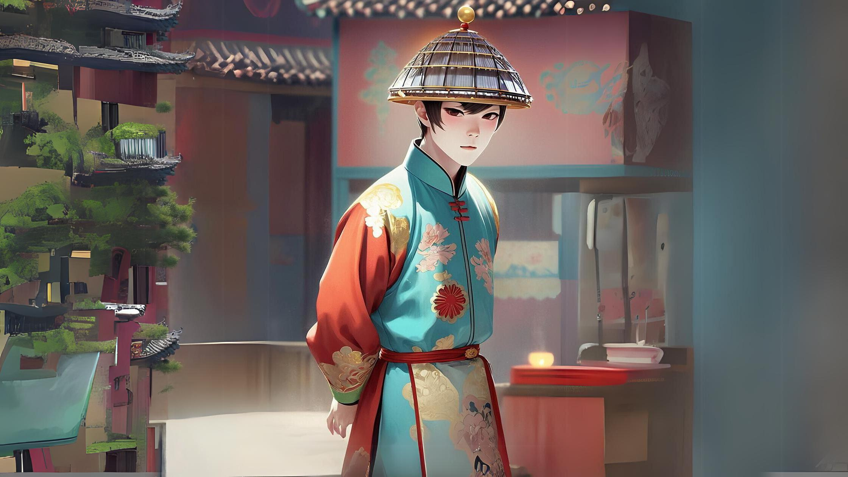
00
自我介紹
大家好，我是LeeLee，從北京來的, 因為種種因素,你們看到的人不是我原來的樣子

Slide 3
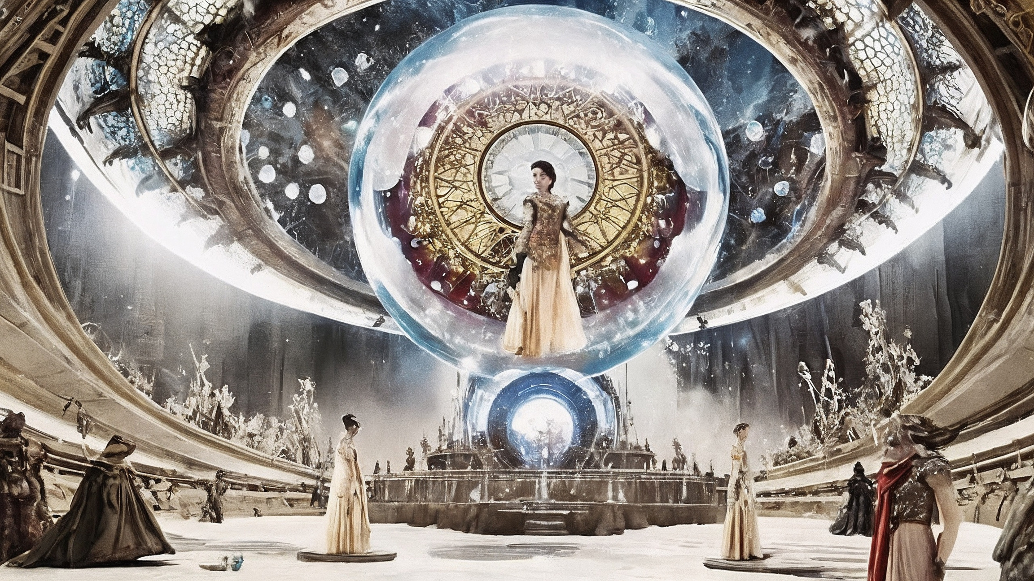
01
目標
我在找Cici，說好要去看元宇宙變裝秀的，我都穿上洋人的騎士服裝了，結果她人就不見了
Notes:
PROMPT : A Metaverse costume show held inside a stunning, futuristic version of the Crystal Palace

Slide 4
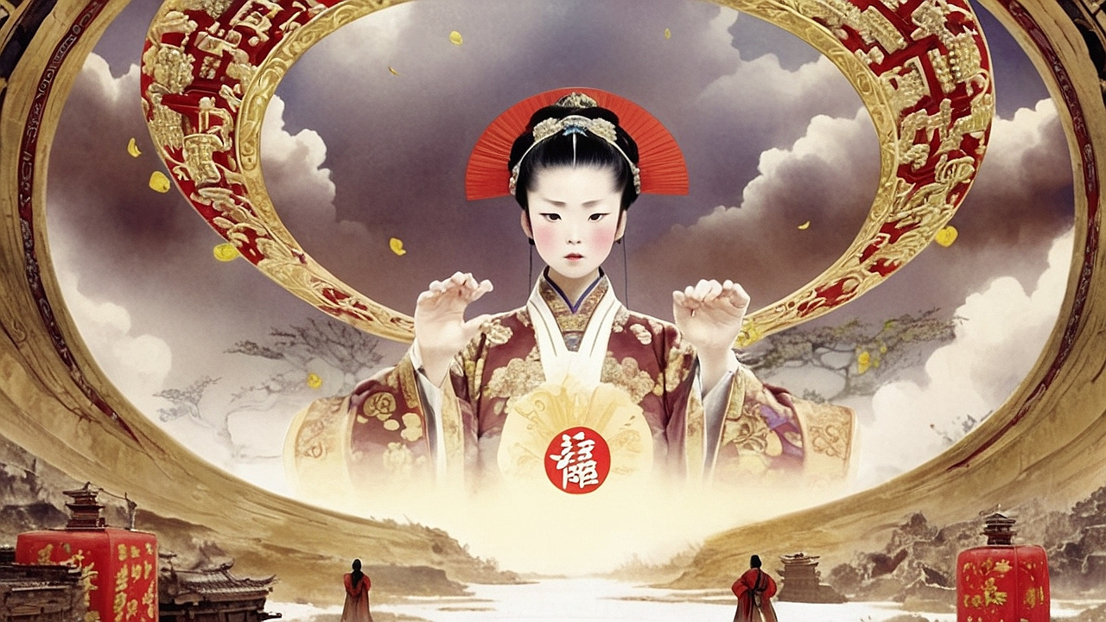
02
阻礙:
我們好像處在兩個不同的空間!!!找不到主子，等一下脾氣大發就糟了!!!甚麼元宇宙?不方便，真討厭!!!!!
Notes:
PROMPT : CIXI, DRESSED IN PLAIN WHITE MANDARIAN COLLAR NO DECORATION LOOSE ROBE, HER FACE STERN AND IMPOSING, STANDS AT THE CENTER, HER FURY FACE, RAISES HER VOICE, COMMANDING ATTENTION, AS SHE ANGRILY SCOLDS A YOUNG EUNUCH, LI, SAYING, 'LI, WHERE HAVE YOU GONE? COME HERE AT ONCE AND ASSIST ME WITH MY ATTIRE!

Slide 5
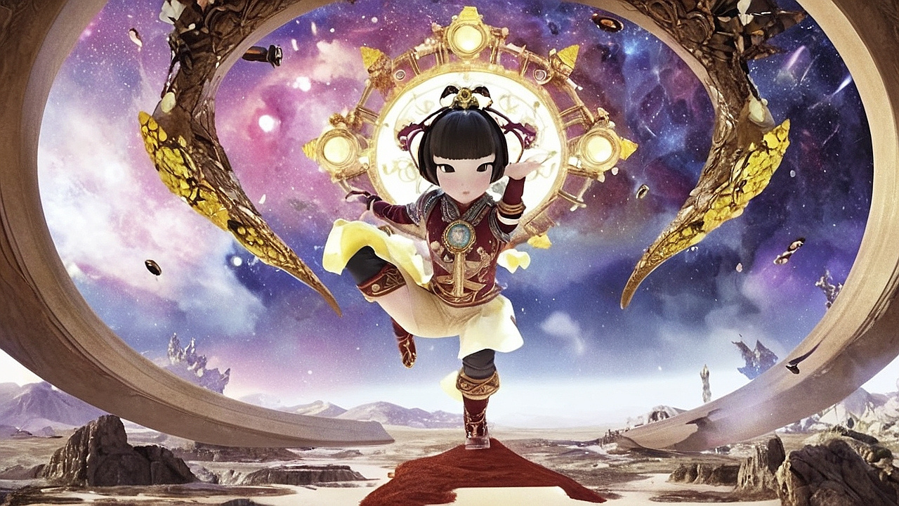
03
努力:
我只能在這裡說說話、不能動，但她好像可以在她的元宇宙裡玩特技呢！
Notes:
PROMPT : EMPRESS CICI IS PLAYING ACROBAT IN METAVERSE

Slide 6

04
結果:
聽說要穿越不同的元宇宙，設定要砍掉重練，這 這要怎麼搞啊0......太不方便了！
Notes:
PROMPT : ? QUESTION MARK FULLFILL WITHIN METAVERSE

Slide 7
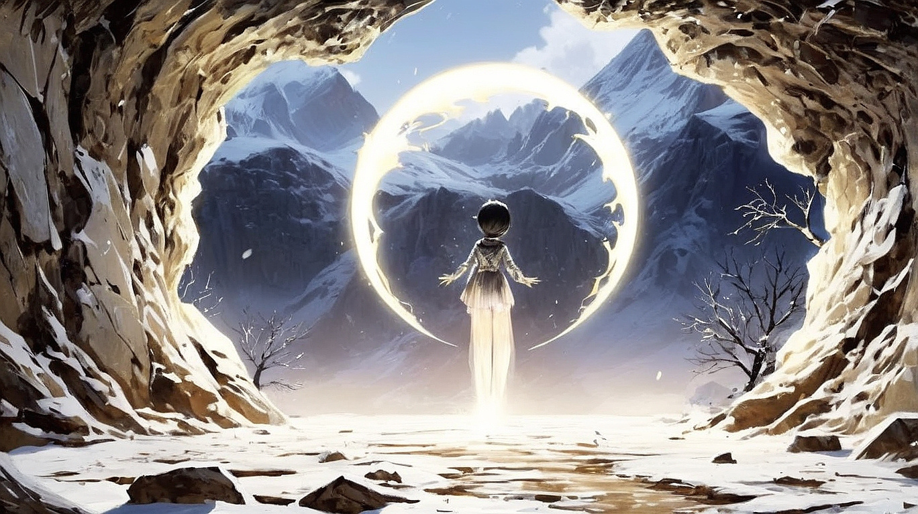
05
意外:
咦！那邊有亮光！（就是這個光，就是這個光，一起唱耶！）有個洞可以鑽過去，我來試試看
Notes:
PROMPT : A DARK, MYSTERIOUS SETTING, WITH DIM SHADOWS OBSCURING THE SURROUNDINGS. SUDDENLY, A FAINT GLIMMER OF LIGHT CATCHES THE EYE, COMING FROM A SMALL, HIDDEN OPENING IN THE WALL. THE AIR IS FILLED WITH CURIOSITY AND A SENSE OF ADVENTURE AS SOMEONE NOTICES THE LIGHT AND EXCLAIMS, 'HUH! THERE’S A LIGHT OVER THERE! THERE’S A HOLE I CAN CRAWL THROUGH. LET ME GIVE IT A TRY

Slide 8

06
轉彎:
啊！他們說只要錢錢夠多就可以，哎！哪個世界不要錢錢啊！從大清王朝到現在，這邏輯都沒有變啊！
Notes:
PROMPT :MONEY SYMBLE MARK FULLFILL WITHIN METAVERSE

Slide 9
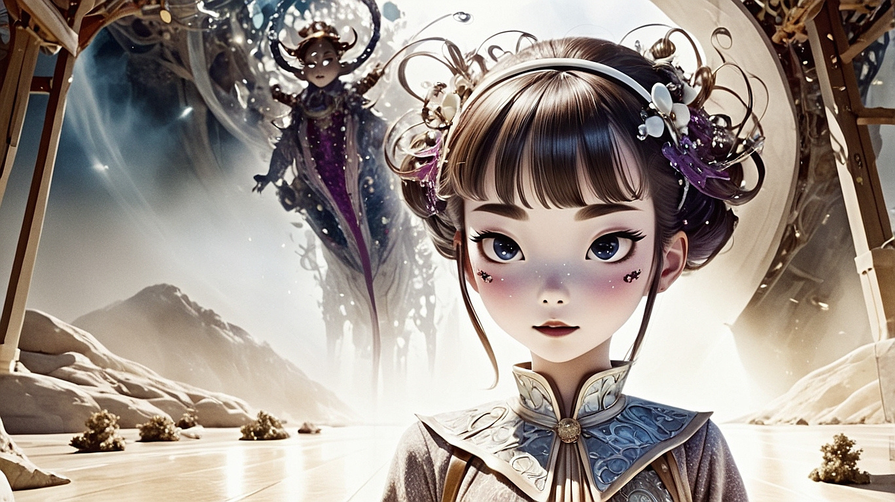
07
結局:
我看到Cici在翻白眼了，我要跳過去了，一二三，跳！
Notes:
PROMPT :IN A WHIMSICAL, PLAYFUL SETTING, A CHARACTER NOTICES CICI ROLLING HER BEAUTIFUL EYES IN A DRAMATIC, EXAGGERATED MANNER. WITH A MISCHIEVOUS GRIN, THE CHARACTER PREPARES TO LEAP ACROSS A GAP OR OBSTACLE, SAYING WITH DETERMINATION, 'I SEE CICI ROLLING HER EYES. I'M GOING TO JUMP OVER THERE. ONE, TWO, THREE, JUMP!

